Slide 1
Django Web Framework

Slide 2
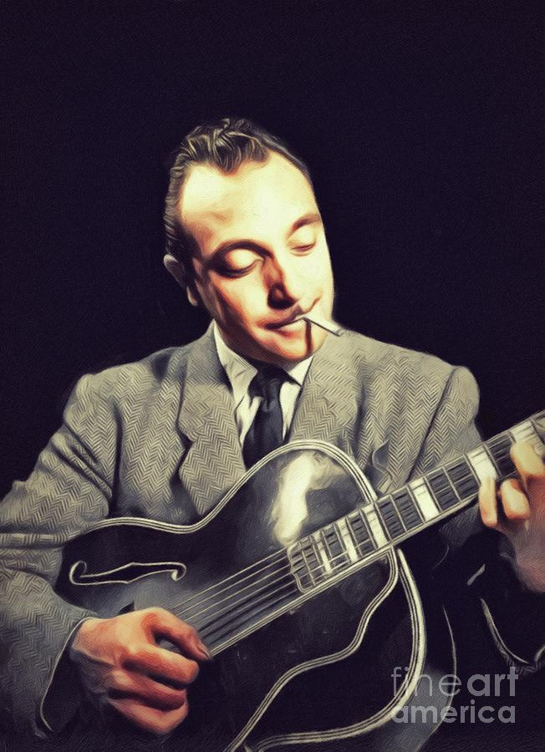
History of Django
Started in 2003 by Simon Willison and Adrian Holovaty at Lawrence Journal-World newspaper in 2003 as an alternative to PHP
Released open source (BSD) a year later
Named after noted jazz guitarist Django Reinhardt
Django Software Foundation was founded in 2008
to oversee further development and maintenance

Slide 3
Django is an MVC framework
MODEL
VIEW
CONTROLER

Slide 4
Model
Define your data types
Has three main components:
Python data classes
A relational database
ORM (Object Relation Mapper)

Slide 5
View
Views process HTTP requests and prepare a response
Comprised of two main components
Views, python functions or classes which handle the request and response cycle
Templates, which aid in the formatting of HTML

Slide 6
Controller
In Django, the controller component is called “URLs”
URLs match URL patterns to views
They can also pass data encoded in a URL to a view

Slide 7
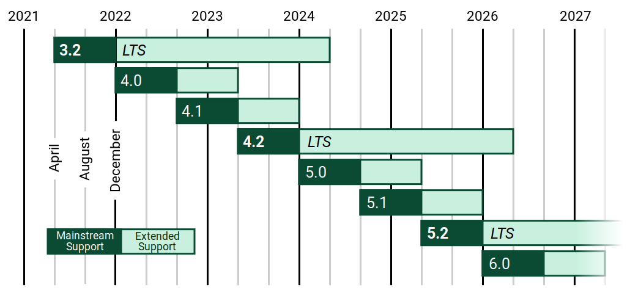
Django keeps going…
Django is still under active development with new features and improvements added regularly

Slide 8
Educational resources
The Official Django tutorial: https://docs.djangoproject.com/en/4.1/intro/tutorial01/
Django Documentation: https://docs.djangoproject.com/en/4.1/
W3 schools: https://www.w3schools.com/django/

